Slide 1
A1: Elastic Search vs rdbms
Tutorial

Slide 2
Overview
Conventional Relational Database Management Systems
Infrastructure Services on a Cloud System
Distributed Database concepts and implementation
Relational Database on a Cloud VM

Slide 3
Relational DBMs
A Relational Database Management System (RDBMS) is a DBMS that is based on the relational model.
The data in an RDBMS is stored in database objects which are called as tables. This table is basically a collection of related data entries and it consists of numerous columns and rows.
SQL constraints: Primary Key, Foreign Key, Index, Unique, Default, Not null, Check
Data Integrity:
Entity Integrity (no duplicate rows),
Domain Integrity − (field type and format validation),
Referential integrity (rows referenced by other records can’t be deleted),
User-Defined Integrity – custom tailored rules enforcing business constraints.
Relational schemas are often normalized before storing on to the Database.

Slide 4
Infrastructure Services on a Cloud System
Cloud service provides consumers with processing, storage, networks, and other fundamental computing resources where the consumer is able to deploy and run arbitrary software, which can include operating systems and applications.
A consumer does not manage or control the underlying cloud infrastructure.
BUT they have the control over operating systems, storage, and deployed applications and possibly limited control of select networking component
Providers supply these resources on-demand from their large pools of equipment installed in data centres.
Infrastructure as a Service (IaaS) - Amazon Web Services, IBM Bluemix and Microsoft Azure.

Slide 5
Distributed dbms
Distributed Database is a collection of multiple interconnected databases, which are physically spread across various locations that communicate via a computer network.
A Distributed Database Management System (DDBMS) is a centralized software system that manages a distributed database in a manner as if it were all stored in a single location.
DBMS allows applications to access data from local and remote databases.
In a Distributed Database data is split into fragments horizontally and vertically which increases parallelism and provides better disaster recovery.

Slide 6
Elastic search
Real-time and distributed full text search and analytics engine.
Optimized for text based and document search
Built on top of Lucene
It has features for search, filtering scoring and ranking of documents
Favours denormalization of data as opposed to RDB systems.
The ELK stack: Elasticsearch, Logstash and Kibana
Use cases:
https://www.elastic.co/blog/found-uses-of-elasticsearch
https://www.elastic.co/use-cases

Slide 7
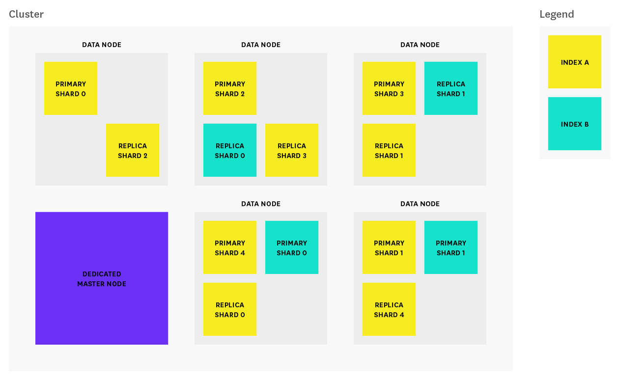
Elastic search
Distributed and Highly Available
Index : Index created on several types of documents
Cluster : Several nodes run in a cluster to store data and speed up searches.
Shards : Indexes are fragmented horizontally in smaller instances and stored across several nodes
Replicas: Copies of shards/ indexes acting as redundancy for recovery and protection against data loss.
*http://serkansakinmaz.blogspot.ca/

Slide 8
Assignment 1 tasks

Slide 9
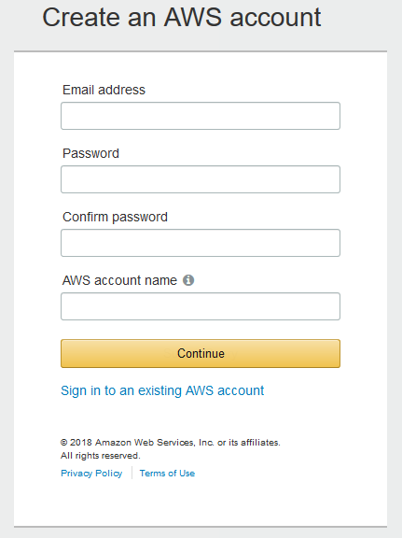
Setup of aws account on amazon
Creation and setup is relatively easy, just follow the steps.
AND it’s free.

Slide 10
CREATING ec2 instance

Slide 11
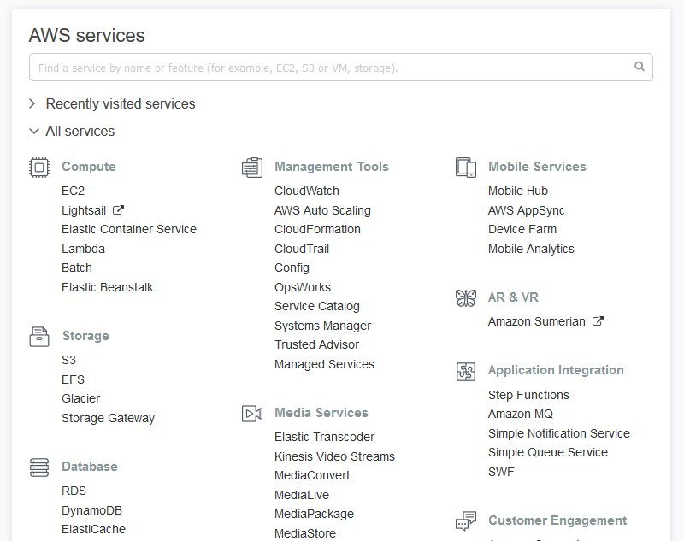
Creating ec2 instance
After you setup the AWS account, go to the AWS dashboard.
Now, we will create EC2 instance.

Slide 12
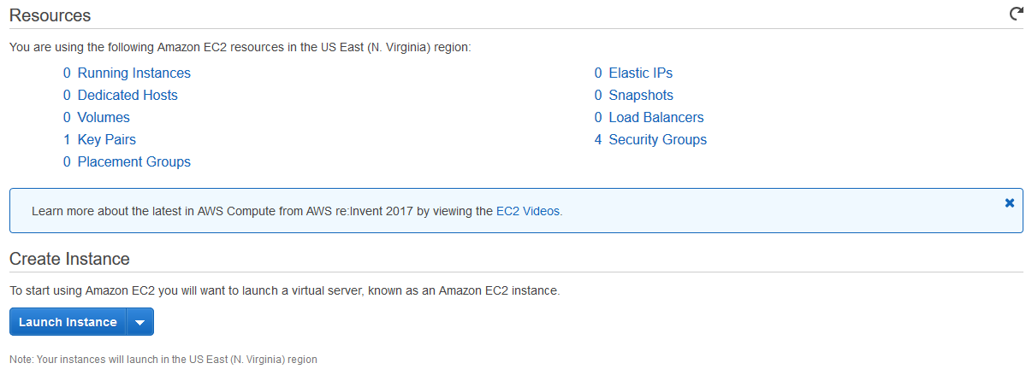
Creating ec2 instance
Click on Launch Instance to activate the wizard

Slide 13
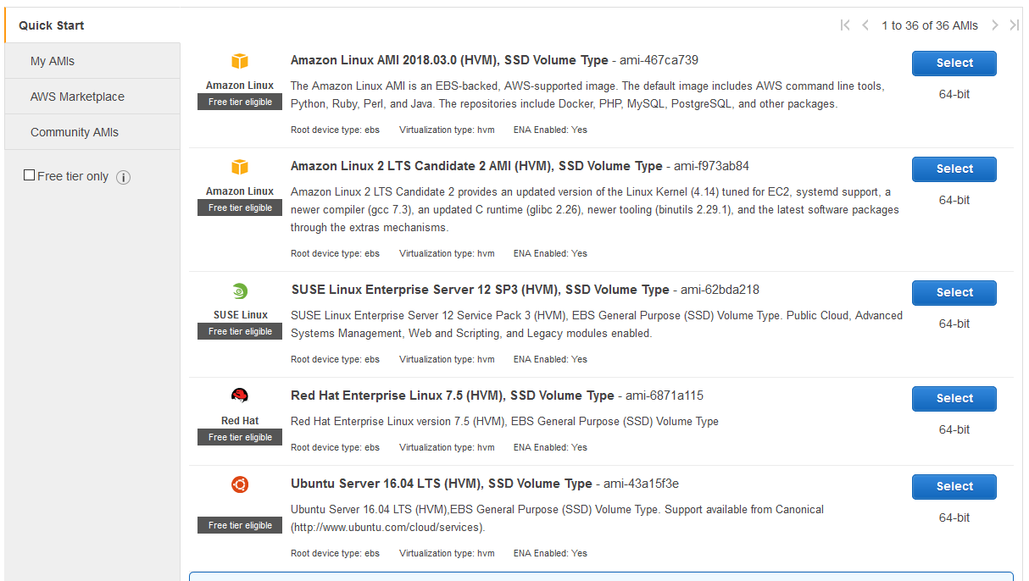
EC2 step 1

Slide 14
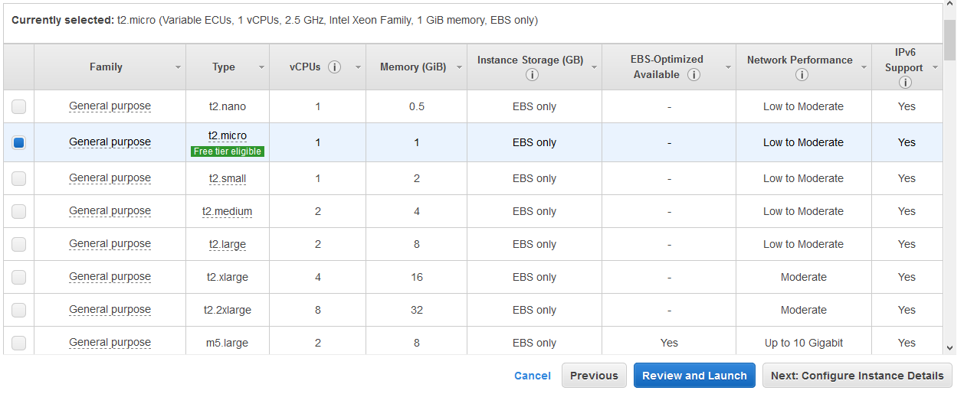
EC2 step 2

Slide 15
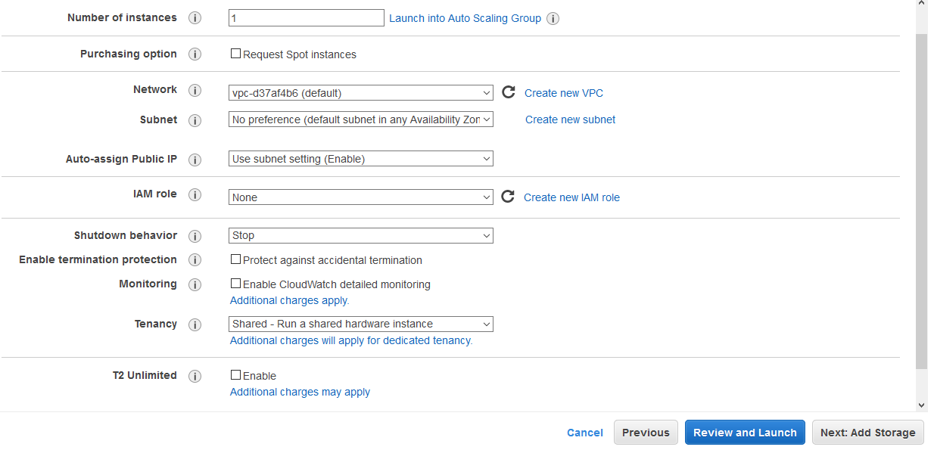
EC2 step 3

Slide 16
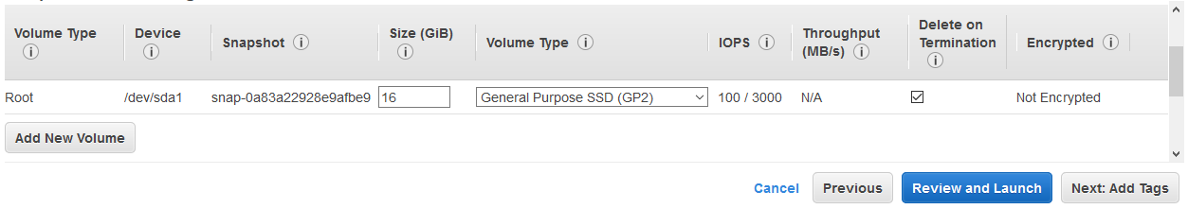
EC2 step 4

Slide 17
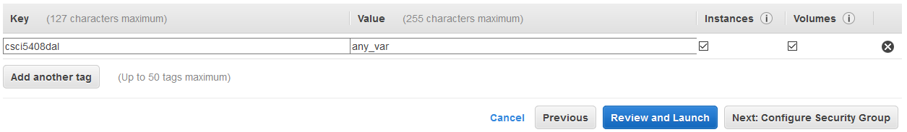
EC2 step 5

Slide 18
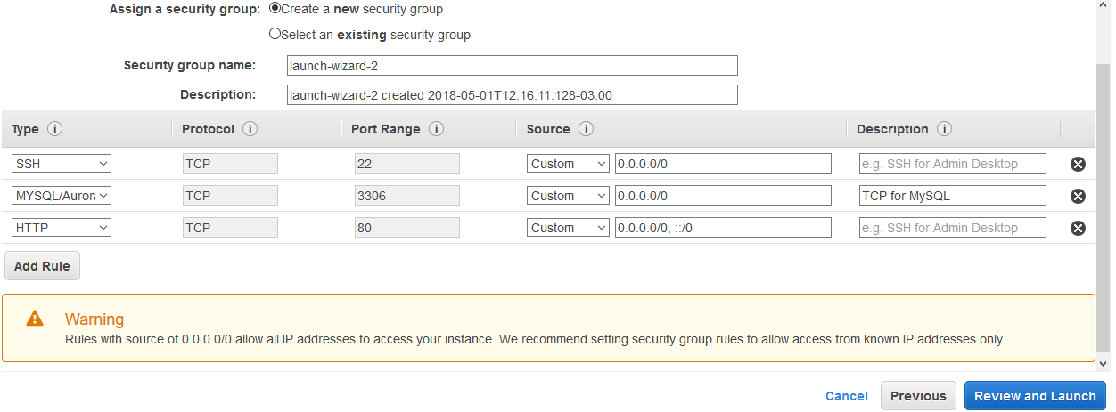
EC2 step 6

Slide 19
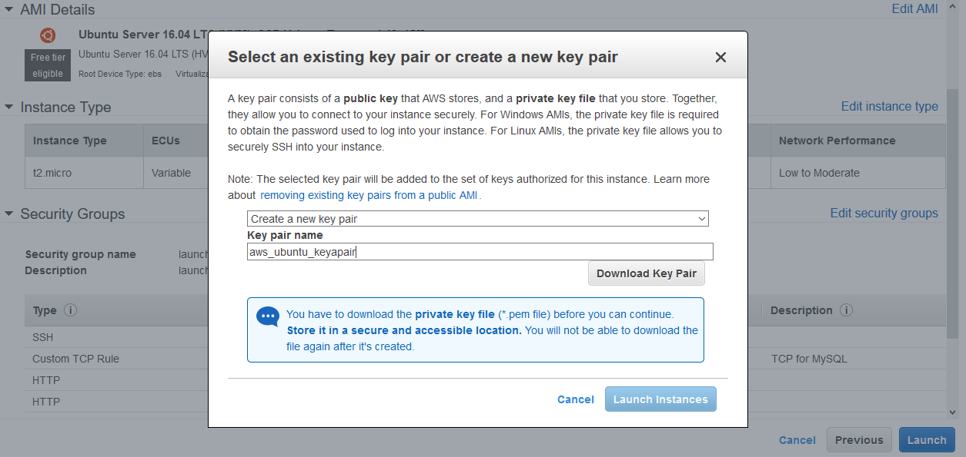
EC2 step 7

Slide 20
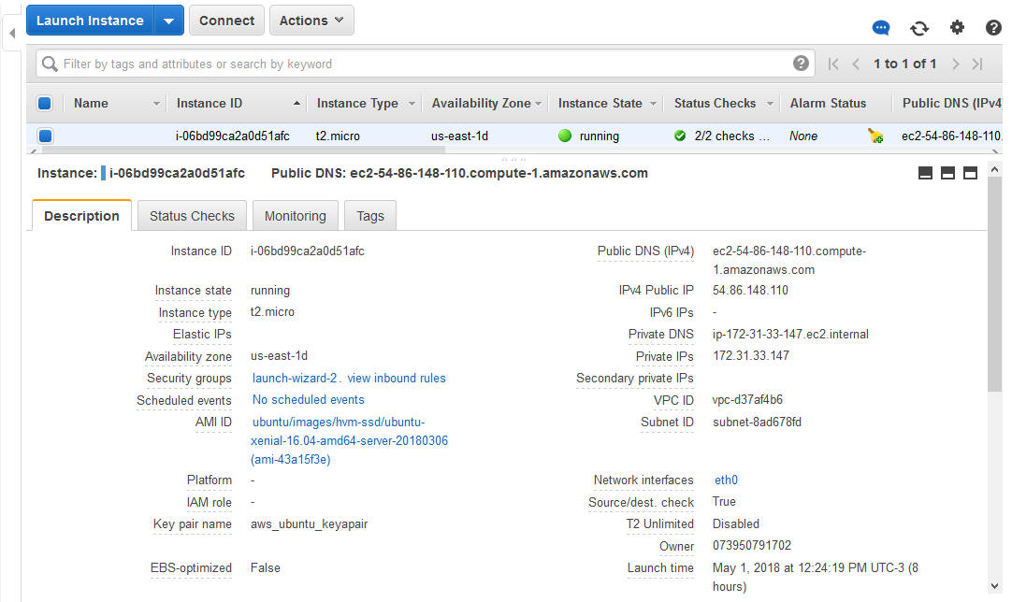
Ec2 Instance and dns information

Slide 21
SSH connection

Slide 22
Connect to the EC2 instance from SSH
For this step we need an SSH client. We are using Putty for Windows.
Download Putty and Puttygen from here:
http://www.chiark.greenend.org.uk/~sgtatham/putty/download.html
• Use the key-pair you downloaded before to generate private key.

Slide 23
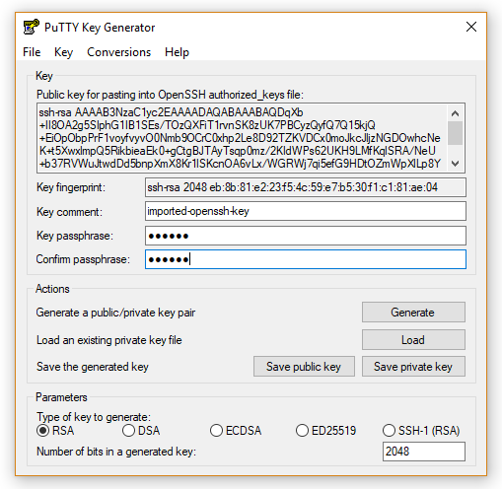
Creating Key-pair with puttygen
Open the PuttyGen executable.
Load the downloaded .pem key file from AWS.
Provide the key passphrase and don’t forget it!
Save the key pair
This will be used whenever you connect to the EC2 instance
Ubuntu/Mac users can use any available tool for their OS

Slide 24
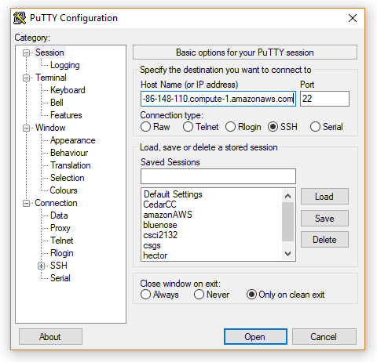
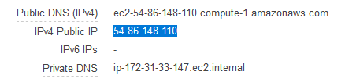
Connecting through putty step 1
Open Putty and enter the Public IP/DNS of the Cloud instance

Slide 25
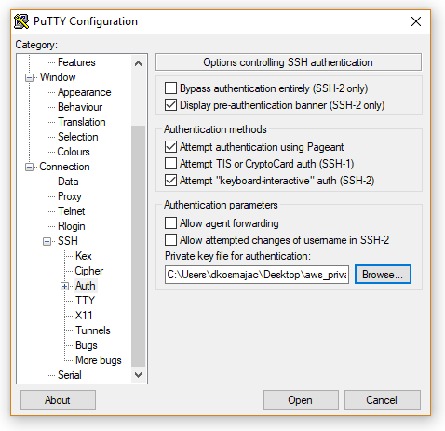
Connecting through putty step 2
Load the Putty Key-Pair
Locate under Connection → SSH → Auth
Browse and load *.ppk key-pair file
Click OPEN

Slide 26
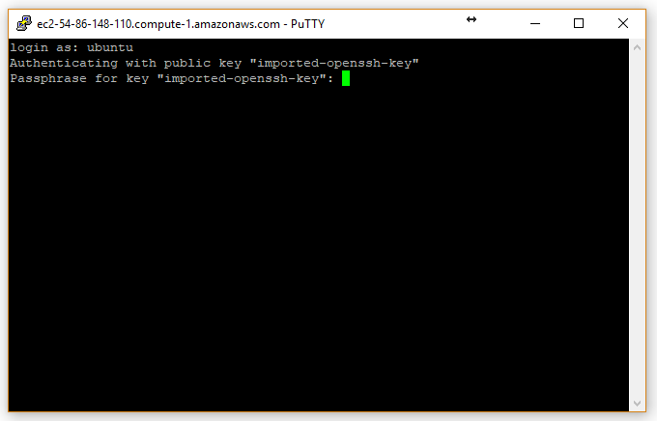
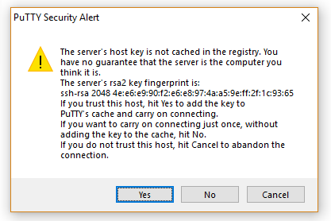
Connecting through putty result
Username will be Ubuntu
Passphrase is the one you entered while creating key-pair in PuttyGen

Slide 27
INSTALLING MYSQL

Slide 28
Installing rdbms on ec2 instance
Once you log in your EC2 instance, you can install the RDBMS.
Important! First update packages:
sudo apt-get update
Then install MySQL server:
sudo apt-get install mysql-server
You can use next command to setup your installation (optional):
mysql_secure_installation don’t use this, many students faced problems

Slide 29
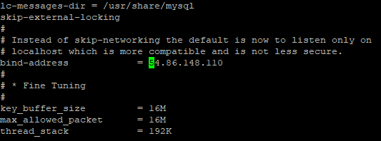
Remote connection to mysql db
Now we have to enable remote connection:
sudo nano /etc/mysql/mysql.conf.d/mysqld.cnf
Look up bind-address field, by
default it should be 127.0.0.1.
Change it to 0.0.0.0
Restart the service after saving:
sudo systemctl restart mysql.service

Slide 30
Setup user and db
Now connect to mysql-server with the client:
mysql -u root -p
Create new user:
CREATE USER 'myuser'@'localhost' IDENTIFIED BY 'mypass’;
CREATE USER 'myuser'@'%' IDENTIFIED BY 'mypass’;
GRANT ALL ON *.* TO 'myuser'@'localhost’;
GRANT ALL ON *.* TO 'myuser'@’%’;
Create database:
CREATE DATABASE busDB;

Slide 31
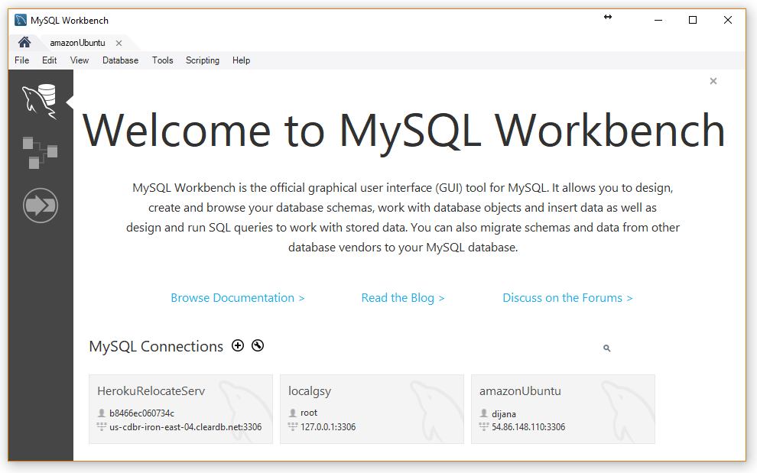
Connect through mysql workbench
Assuming that you have locally installed Workbench, you should be able to connect and import SQL data easily.

Slide 32
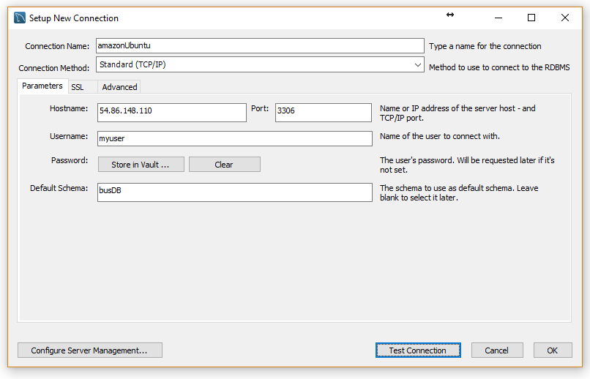
Connect through mysql workbench
Select Create new connection from the home screen and use your instance settings.

Slide 33
Installing elastic search and logstash

Slide 34
Elastic search – java installation
In order to complete the tasks in assignment you need to install ElasticSearch , Logstash and optionally Kibana.
ElasticSearch and Logstash require Java installation.
To Add the Oracle Java PPA to apt run:
sudo add-apt-repository -y ppa:webupd8team/java
sudo apt-get update
Install oracle java8 installer
sudo apt-get -y install oracle-java8-installer

Slide 35
Elastic search Installation
Run the following command to import the ElasticSearch public GPG key into apt:
wget -qO - https://packages.elastic.co/GPG-KEY-elasticsearch | sudo apt-key add -
Http transport should be enabled (important):
sudo apt-get install apt-transport-https
Create the Elasticsearch source list:
echo "deb https://artifacts.elastic.co/packages/6.x/apt stable main" | sudo tee -a /etc/apt/sources.list.d/elastic-6.x.list
Update apt package
sudo apt-get update

Slide 36
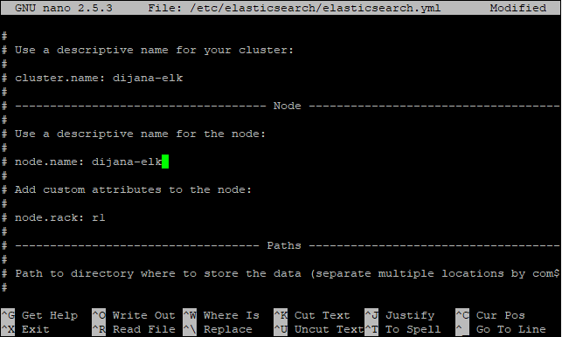
Elastic search Installation
Install ElasticSearch
sudo apt-get -y install elasticsearch
Update the configuration file located by:
sudo nano /etc/elasticsearch/elasticsearch.yml
Uncomment and provide cluster and node name:

Slide 37
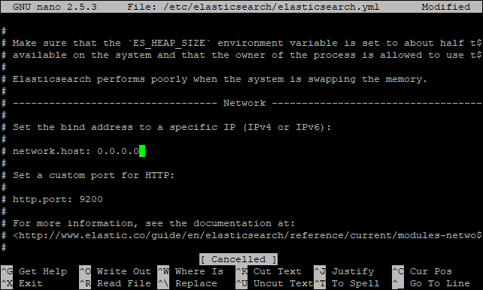
Elastic search Installation
In the same file configure the network host. Originally it should be 127.0.0.1. Change it to 0.0.0.0 and save.
Restart the service:
sudo service elasticsearch restart
Run to start elasticsearch on boot up:
sudo update-rc.d elasticsearch defaults 95 10

Slide 38
Elastic search Installation – common issue
You might have a problem with starting ElasticSearch. Test if it’s running:
sudo service elasticsearch status
The problem might be with jvm allocated memory. You can adjust this by lowering the size of initial heap:
sudo nano /etc/elasticsearch/jvm.options
Change to and save.
Restart the service:
sudo service elasticsearch restart
-Xms1g
-Xmx1g
-Xms512m
-Xmx512m

Slide 39
Elastic search - TEST
You can use any REST client you like. Some of the suggestions are curl for linux distros, or gui oriented ones. In the browser try:
http://<your_ec2_ip>:9200/
If everything is configured well, you should get 200 response from ES.

Slide 40
Elastic search - TEST
In the example the REST client is Insomnia. First, before data import, we need to create indexes.
Let’s create index schools
PUT http://<your_ec2_ip>:9200/schools
This is basic configuration. In the request body you can pass some details. Please refer to official documentation.

Slide 41
Elastic search - TEST
After index creation, now you can import the data. In case you want to do bulk insert, your request might look like this:
POST http://<your_ec2_ip>:9200/schools/_bulk
The request body should contain data in the form:
{"index":{"_index":"schools", "_type":"school", "_id":"1"}}
{ "name":"Central School", "description":"CBSE Affiliation",…}
Please note that one record must be in one line, otherwise you might get eof error.

Slide 42
Elastic search - TEST
After data insert, you should be able to do queries:
GET http://<your_ec2_ip>:9200/schools/_search?q=tags:sports
The response would look like this:
{{"took": 27,
"timed_out": false,
"_shards": {… },
"hits": {…
"total": 1,
"max_score": 0.2876821,
"hits": [{…"tags": ["Good Faculty","Great Sports”],"rating": "4.5"}…]}
}
}"index":{"_index":"schools", "_type":"school", "_id":"1"}}
{ "name":"Central School", "description":"CBSE Affiliation",…}…

Slide 43
Elastic search - TEST
Same thing you can achieve with:
GET http://<your_ec2_ip>:9200/schools/_search
Adding the request body:
{
"query":{
"query_string":{
"query":“tags:sports"
}
}
}

Slide 44
Logstash Installation
The Logstash package is available from the same repository as Elasticsearch
Update apt package:
sudo apt-get update
Install logstash with this command:
sudo apt-get install logstash
Start logstash
sudo service logstash start

Slide 45
ELASTIC SEARCH APis

Slide 46
AVAILABLE APIs
ElasticSearch offers a number of endpoints to work with data
For this assignment you will need:
Index API, Get API, Bulk API, Search API
Documentation on APIs:
https://www.elastic.co/guide/en/elasticsearch/reference/current/docs.html

Slide 47
Index api
Before you start inserting data, you have to create the index.
PUT school
{ "mappings": {
“_doc": {
"properties": {
"name": { "type": "text" },
“city": { "type": "keyword" },
“fees": { "type": “integer" }
} } }
Documentation on Index API:
https://www.elastic.co/guide/en/elasticsearch/reference/current/docs-index_.html

Slide 48
BULK api
One of the multidocument endpoints used for bulk insert.
POST _bulk
{ "index" : { "_index" : “school", "_type" : "_doc", "_id" : "1" } }
{ “name" : “First school" }
{ “index" : { "_index" : “school", "_type" : "_doc", "_id" : "2" } } { “name" : “Second school" }
Documentation on Bulk API:
https://www.elastic.co/guide/en/elasticsearch/reference/current/docs-bulk.html

Slide 49
GET api
Getting a specific document.
POST _bulk
{ "index" : { "_index" : “school", "_type" : "_doc", "_id" : "1" } }
{ “name" : “First school" }
{ “index" : { "_index" : “school", "_type" : "_doc", "_id" : "2" } } { “name" : “Second school" }
Documentation on Bulk API:
https://www.elastic.co/guide/en/elasticsearch/reference/current/docs-bulk.html

Slide 50
SEARCH api
One of the multidocument endpoints used for bulk insert.
POST _bulk
{ "index" : { "_index" : “school", "_type" : "_doc", "_id" : "1" } }
{ “name" : “First school" }
{ “index" : { "_index" : “school", "_type" : "_doc", "_id" : "2" } } { “name" : “Second school" }
Documentation on Bulk API:
https://www.elastic.co/guide/en/elasticsearch/reference/current/docs-bulk.html

Slide 51
Useful references
Kibana installation is available at
https://www.elastic.co/downloads/kibana
Documentation on ElasticSearch and Logstash:
https://www.elastic.co/guide/index.html
Blog about ElasticSearch concepts:
https://www.datadoghq.com/blog/monitor-elasticsearch-performance-metrics/
ElasticSearch API tutorial:
https://www.tutorialspoint.com/elasticsearch/index.htm

